Slide 1







ENHANCING MUSIC DISCOVERY AND ANNOTATION WORKFLOWS WITH
AUTOMATED CHORUS
DETECTION
Data Science Intensive Capstone Project
Author: Dennis Dang
Mentor: Andrea Constantinof PhD

Slide 2

CHALLENGES OF MUSIC DISCOVERY
User data-driven recommendation systems are biased towards popular artists
Manual music annotation is costly
Solution: Automated Music Annotation
Notes:
In today's landscape of digital music consumption, streaming platforms like Apple Music, Spotify, and YouTube Music contain an overwhelming amount of content, with Spotify alone boasting a library of over 100M+ songs. While this diversity is a remarkable asset, it also poses significant challenges for data driven music discovery and annotation processes.
User data-driven rec systems have become increasingly reliant on algorithms biased towards already popular artists. Providing user recommendations based on other users behavioral patterns leads to a self-perpetuating cycle that makes it difficult for emerging artists to gain exposure. However, it is a cost-efficient method of providing recommendations compared to the process of manually annotating and categorizing a large collection of music. Automated music annotation offers a solution to these challenges. In other words, I’m proposing that we have the music label itself.

Slide 3
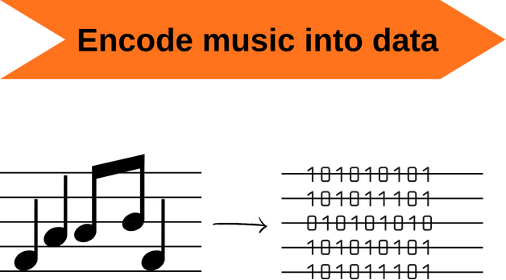
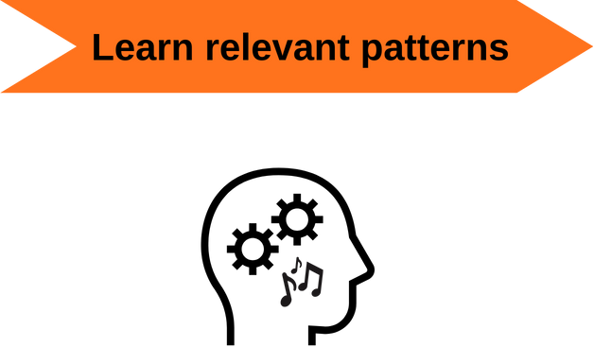
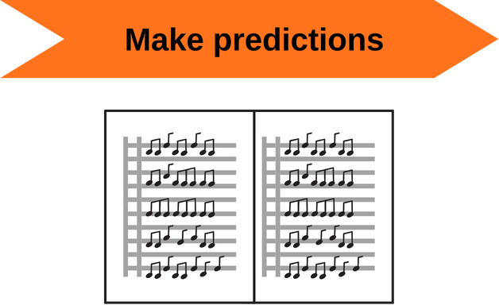
AUTOMATED MUSIC ANNOTATION
Design intelligent systems to…
Notes:
In the realm of automated music annotation, our goal is to design intelligent systems that can take a piece of music, turn it into a numerical representation, learn the patterns and associations surrounding musical attributes, and make predictions and recommendations based on music content.

Slide 4

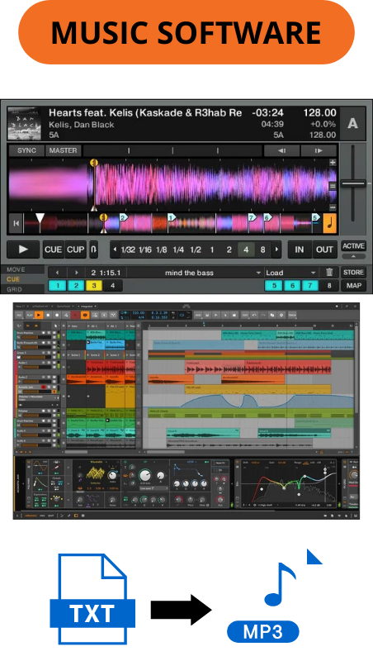

STAKEHOLDERS
Notes:
The impact of automated music annotation has far-reaching implications in the music industry and other tangential industries. Streaming platforms can improve their music discovery pipelines with high-fine-grained annotated music data, music softwares can streamline workflows and introduce innovative features, and artists and ad agencies can leverage these technologies to streamline promotional content creation.

Slide 5
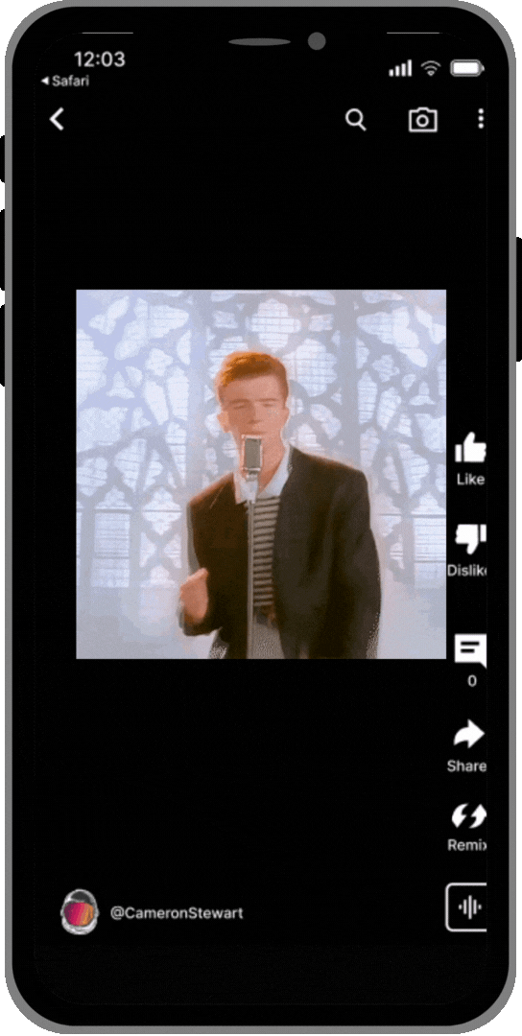

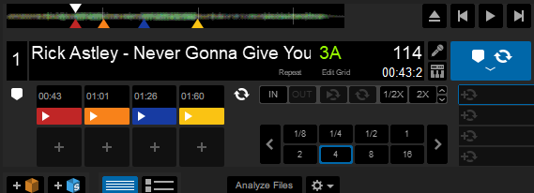
AUTOMATED CHORUS DETECTION
Automatically identify the most memorable and representative parts of a song
Automatically generate engaging content for artists on streaming platforms
Automatically generate labeled segments (for DJing or Music Research)
Notes:
One specific application of automated music annotation that I’m here to share today is the ability to automatically identify the chorus section of a song, which is often times the most memorable and representative part of a song. In this video, i show a demo of the command line interface i’ve prototyped that employs a digital signal processing pipeline and a pre-trained neural network model to locate the exact times of a chorus given a Youtube link.
Given this technology, artists and content creators can also generate engaging content for social media.. or promotional content at scale.
Additionally, these labeled segments can provide valuable annotated data for music producers and live-performing DJs and for music research.

Slide 6
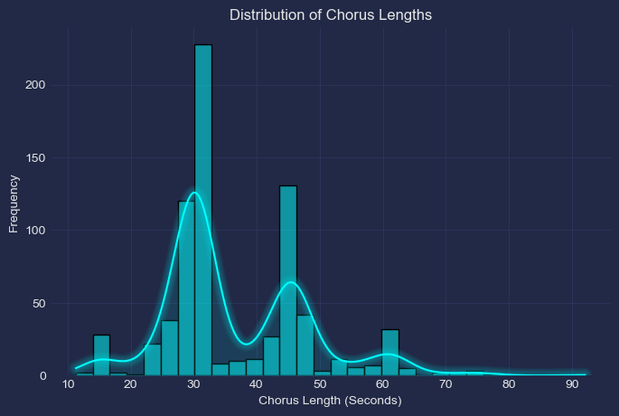
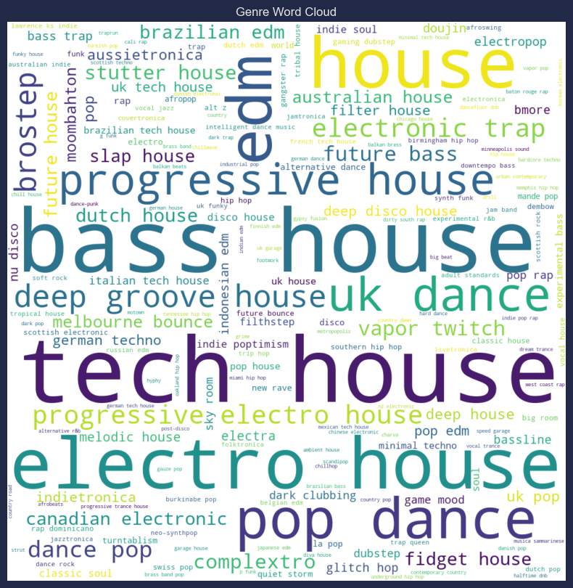
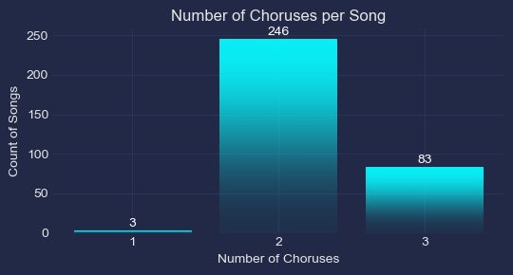
DATA COLLECTION
What is a chorus?
A distinctive section of a song that showcases the primary or recurring theme, and significantly contributes to the song's identity and emotional impact
Established criteria for labeling choruses (refer to Annotation Guide)
332 songs from mostly electronic music genres
Notes:
Before diving into the technical aspects of our automated chorus detection system, it’s essential to establish a clear understanding of what constitutes a chorus within a piece of music. We defined a chorus as a distinctive section of a song that showcases the primary or recurring theme, and significantly contributes to the song's identity and emotional impact. This qualitative definition, along with a couple other operational criteria, guided us to create a labeled dataset of 332 songs, mostly from electronic music genres. We chose to limit our initial dataset to a single or similar set of music genre to allow us to focus on developing and refining our methodology, and increase complexity later to deal with a wide variety of musical styles.

Slide 7
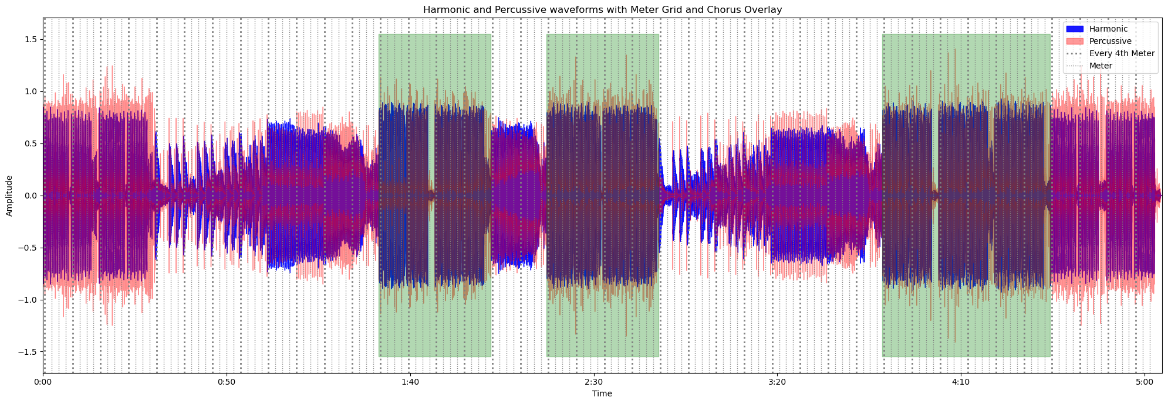
EXPLORATORY DATA ANALYSIS
Using visualizations to identify choruses
Chorus labels overlaid in green
Musical meters overlaid as dotted lines. Every 4th meter emphasized
Which features can I visually identify the chorus with?
Which features behave differently during the chorus vs. non-chorus?
Does this feature align with the meter structure of the song, particularly in chorus sections?
Notes:
After we collected data, we explored how certain audio characteristics might differ from choruses to non-choruses. To do so, we used visualizations of our audio signal where we overlaid the labeled chorus sections in green along with a music meter grid. With each audio property that we visualized we asked ourselves questions such as: "Which features can I visually identify the chorus with?" and "Which features behave differently during the chorus versus non-chorus sections?". Answering these questions laid the foundation for our future feature engineering and model development efforts.

Slide 8
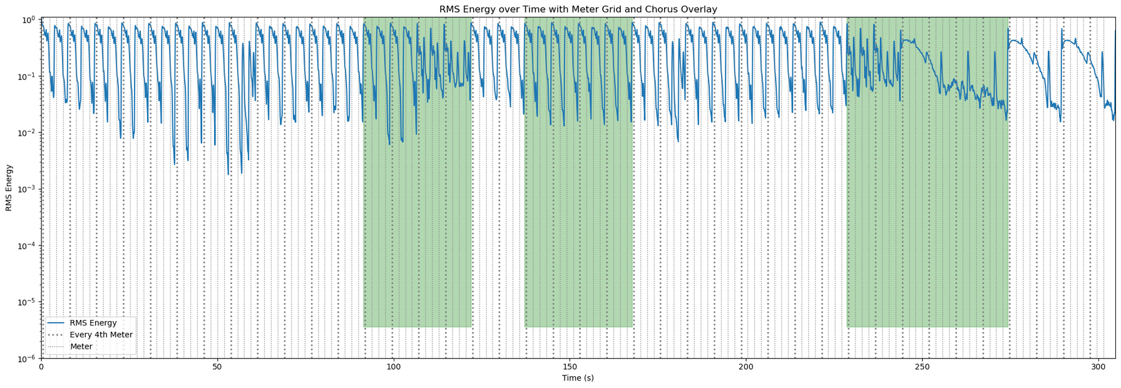
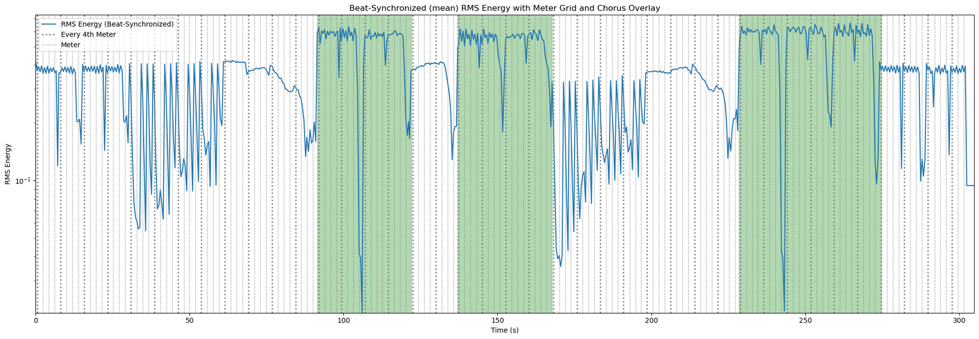
ROOT MEAN SQUARE ENERGY:
Average magnitude (loudness) of an audio signal over a specific time window
Low dimensional feature (1 x n_timesteps) (1 x 40000 audio frames)
BEAT-SYNCED RMS ENERGY:
Mean interpolation of RMS Energy between each beat
Chorus sections become distinguishable
Highlights the importance of rhythmic structure when analyzing audio features
Notes:
Root Mean Square (RMS) energy measures the average magnitude or loudness of an audio signal over a specific time window. It’s a low dimensional feature, being essentially a 1d array that is the length of however many audio frames there are in that signal. Here we see that we can’t really distinguish the chorus from non-chorus, if anything our 3 chorus sections look different from each other. However, in this example, that time window of analysis is set to an arbitrary length of around 10 ms. If this were any audio signal, like a recording of human speech, an arbitrary window length might be sufficient for analysis. However, when we deal with certain types of music, rhythmic and temporal features give us direct insight into how the song was produced.
In this example below, we transform the RMS energy signal by synchronizing it to the beat of the song. This is achieved by calculating the mean or average RMS energy between each beat interval. In doing so, we capture the energy levels at rhythmically significant points in the music, rather than using an arbitrary window length of 10 ms and the results are surprising. Before, we had no way of tell which sections are choruses if the green overlay didn’t exist. However, by syncing our audio feature to the rhythm of the song, the chorus sections not only look identical to each other, but they also look different from the rest of the song. This observation plays an important role in our feature engineering process later and highlights the importance of considering rhythmic structure when analyzing music.

Slide 9
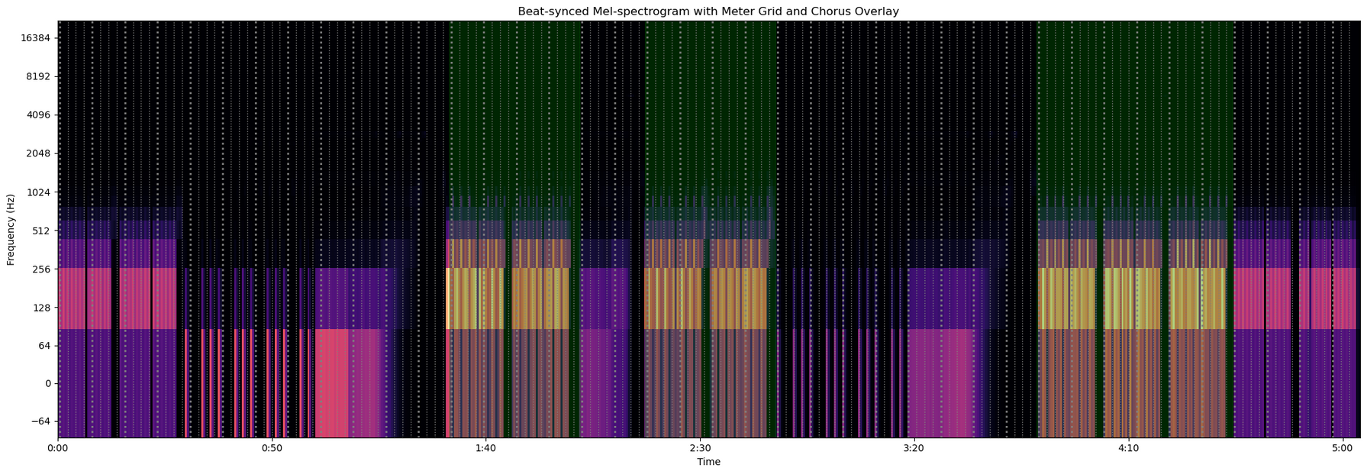
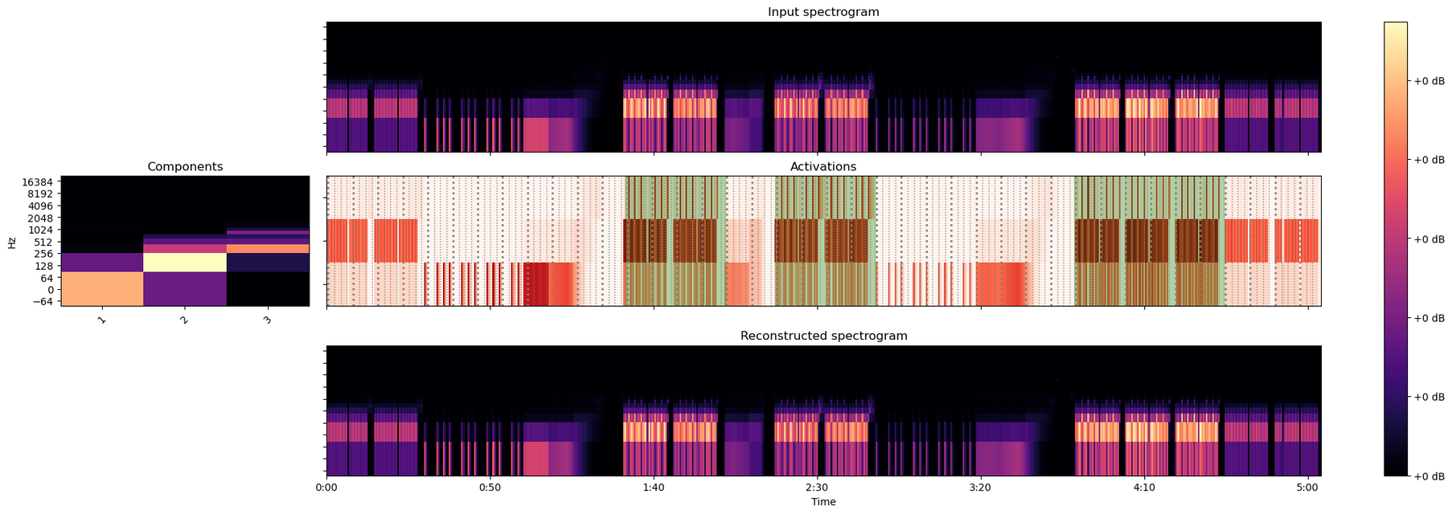
MEL SPECTROGRAM:
Frequency (Hz) of an audio signal over time
High-dimensional feature (n_mel_bins x n_timesteps) (128 x 40000)
DECOMPOSED MEL SPECTROGRAM:
Decompose using Non-negative Matrix Factorization (NMF) into 3 components and time-varying activations
Reduces dimensionality, memory/compute requirements (n_components, n_timesteps) (3, 40000)
Notes:
The next feature we’ll look at is the mel spectrogram. It is a widely used representation in audio research and music information retrieval because it provides are presentation of the frequency content of an audio signal over time on a scale that is designed to match how humans perceive different frequencies.
In the given example, chorus sections can be visually distinguished from non-chorus sections. However, one drawback of spectrograms is that is a high-dimensional feature. For a song like the one used in the example, it can be a 128 x 40000 feature.
To address the high dimensionality of the mel spectrogram, and other features that we explored, we use dimensionality reduction techniques like Non-negative Matrix Factorization (NMF). NMF decomposes the spectrogram into a set of spectral components and activations. in our analysis we found that 3 is an optimal number of components to successfully reconstruct a melspectgrogram.The resulting activations matrix provide us with the necessary information we need to distinguish chorus sections from non-chorus sections, but in a much more concise and computationally efficient form which is important when deploying ML models at scale.

Slide 10
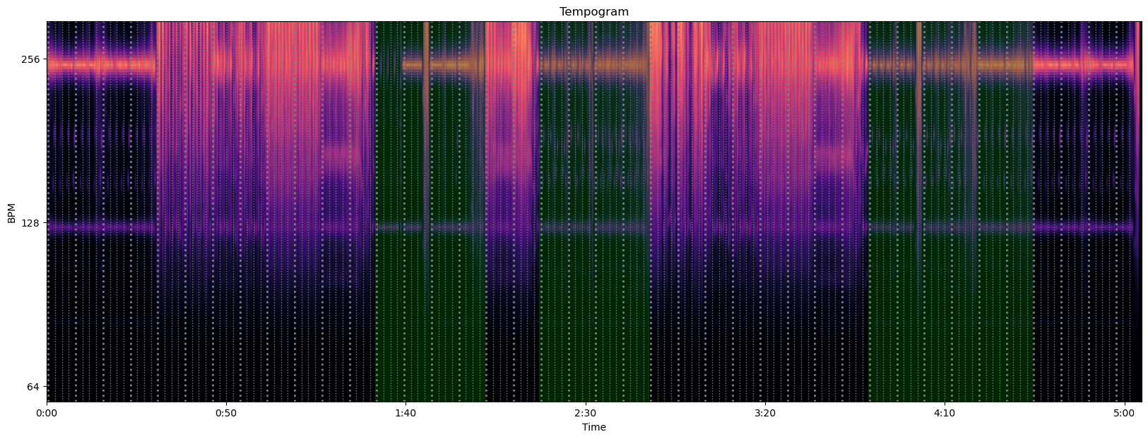
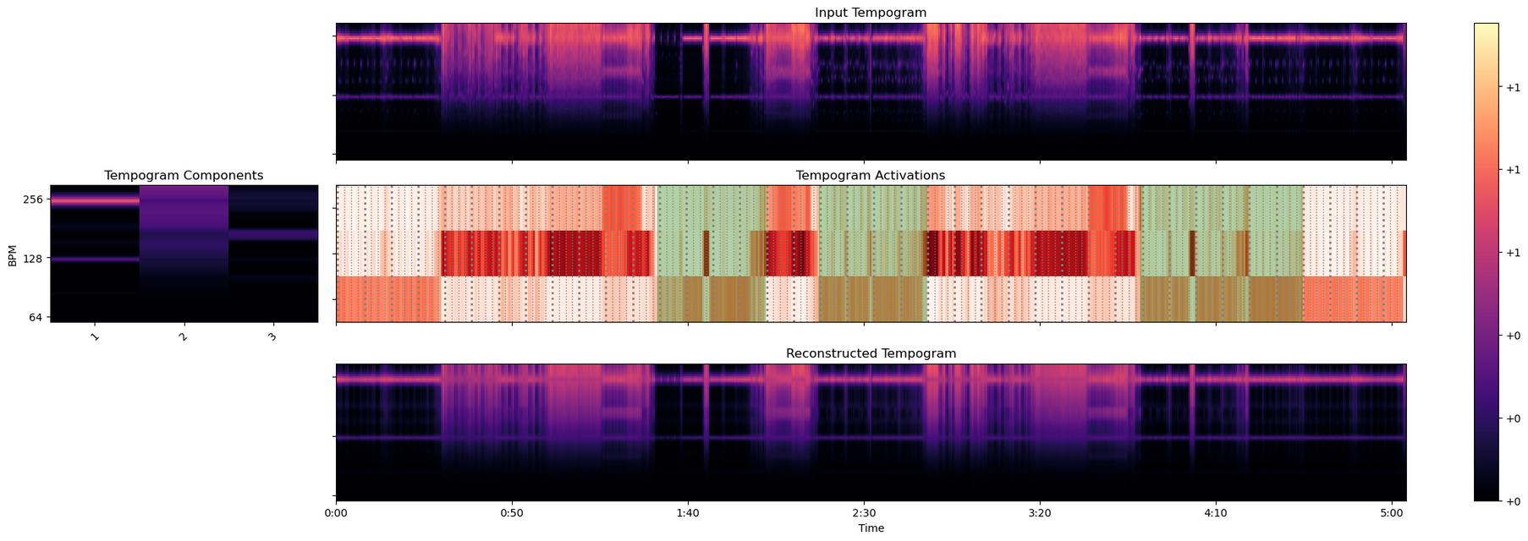
TEMPOGRAM:
Rhythmic/tempo stability over time
Illuminates “conflict resolution” song structure
High-dimensional feature (autocorr_window_size X n_timesteps) (384 x 40000)
DECOMPOSED TEMPOGRAM:
Decomposed using NMF into 3 components and activations
Notes:
Next we have the tempogram which provides us with a numerical representation of how energy is distributed across different tempos/rhythms. It essentially measures rhythmic and tempo stability.
High energy areas suggest high instability or variations in rhythm. While low energy and variance, such as these horizontal lines and during the chorus sections, indicate the presence of a stable tempo during the time period. In the given example, chorus sections exhibit less rhythmic variability and seem to have a stable tempo throughout its duration. Which if you think about music composition in terms of “conflict resolution”, it makes a lot of sense. For example, the composer introduces tension with an accelerating drumroll, then resolves the conflict during the drop or chorus by establishing stability and harmony.
Tempograms are also high dimensional and similarly, can be reduced using NMF like the mel spectrogram

Slide 11
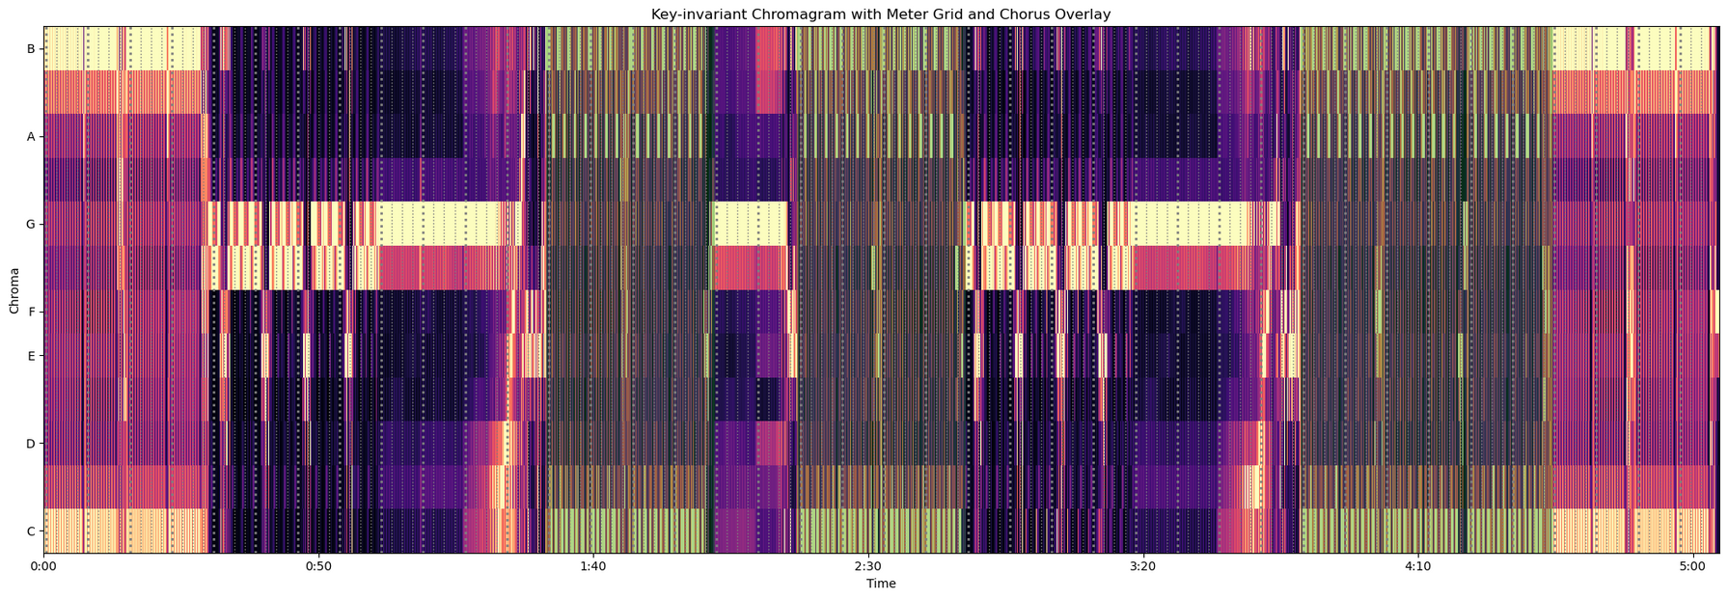
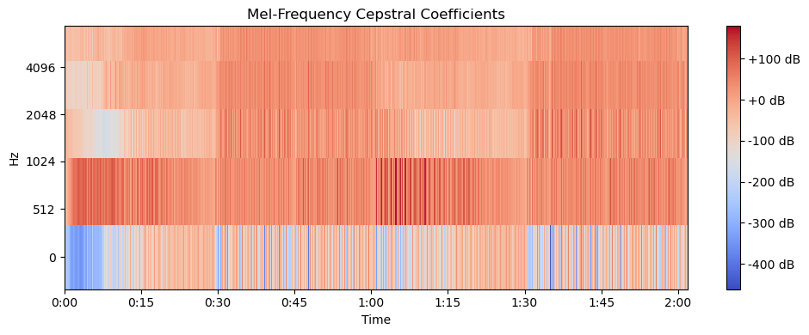
CHROMAGRAM:
Captures tonal content represented as energy across the 12 pitch classes (C, C#, D, D#, E, F, F#, G, G#, A, A#, B)
MEL-FREQUENCY CEPSTRAL COEFFICIENTS (MFCC)
Captures timbral characteristics of the audio signal
Notes:
The last 2 features we consider are chromagrams and Mel-frequency Cepstral Coefficients (MFCCs). The chromagram captures the tonal content of an audio signal and represents them as energy across the 12 pitch classes or musical keys(C, C#, D, D#, E, F, F#, G, G#, A, A#, B) . And
MFCCs capture the timbral characteristics of the audio signal.

Slide 12
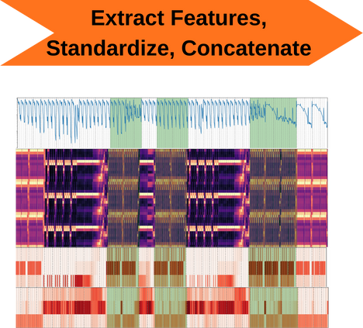

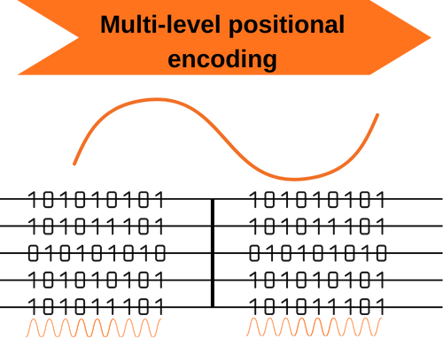
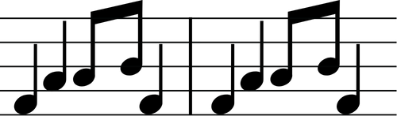
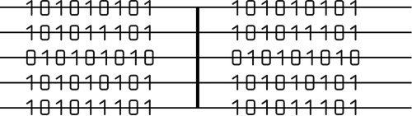
MODEL PREPROCESSING
Convolutional Recurrent Neural Network (CRNN)
Features extracted: RMS energy, chromagram activations, tempogram activations, MFCC activations, mel spectrogram activations (15 dimensions)
Meter-based timesteps: Input shape = (201, 300, 15) (meters, frames, features)
Positionally encode each meter AND each frame in a meter
Notes:
Given our task that involves segmenting and classifying choruses in music, we chose to employ a Convolutional Recurrent Neural Network, or CRNN.
Our first steps during preprocessing was to extract those 5 audio characteristics we talked about earlier, standardize their weights, and concatenate them (essentially stacking them on top of each other). Then we segment our songs
into timesteps. However, based on what we learned in our EDA, we decided to segment our music into timesteps based on the musical meter structure of a song. So just like how music is divided into meaningful units of time…
we divide our data by these same units. Doing so introduces what is known as an inductive bias into a model that will hopefully improve the way it learns.
After the timesteps are created, we positionally encode the audio features, providing the attention layer of our neural network with positional information for each meter in a song and each audio frame within a meter.

Slide 13
MODEL ARCHITECTURE
CRNN Input Shape
Each song contains 201 meters
Each meter contains 300 audio frames
Each audio frame consists of 15 features
Input shape: (201, 300, 15)
Three Convolutional layers to extract frame-level features from each meter
Input shape: (300, 15) (i.e. a meter)
1D convolutional layer -> ReLU activation function -> 1D max-pooling layer (x3)
One Recurrent layer for temporal summarization of the features extracted by CNN
Bidirectional LSTM processes the input sequence in both forward and backward directions
Output shape is (201, 512) (512 LSTM units)
Dense layer applies sigmoid activation function to each time step (meter)
Output shape is (201, 1) representing the probability of a chorus being present at each meter in a song
Notes:
After the preprocessing steps, each song is uniformly padded to have 201 meters, each meter contains 300 audio frames, and each audio frame is made of 15 features.
Each meter of a song is then fed into the convolutional layers where frame-level patterns and features are extracted and summarized. Each conv layer is made of 3 components: a 1d convolutional layer, a ReLu activation function, and a 1d max-pooling layer. Then the output from the last max-pooling layer is reshaped and passed along to the recurrent layer.
The recurrent layers consists of one bidirectional long short term memory layer that captures long-range patterns from the input data.
The output is then passed along to a fully-connected dense layer where a sigmoid activation function is applied to each meter time step. The resulting output is a 1D array representing the probability of a chorus being present at each meter in a song.

Slide 14
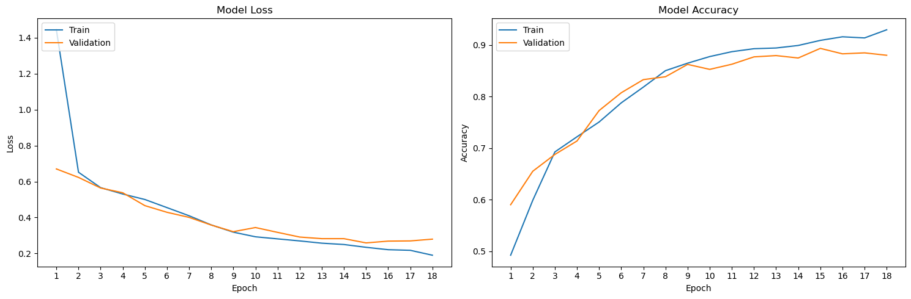
MODEL TRAINING
Trained over 50 epochs using the training and validation datasets
Callbacks:
ModelCheckpoint: Save the best model based on minimizing validation loss (binary cross entropy)
EarlyStopping: Stop training if validation loss doesn't improve for 3 epochs
ReduceLROnPlateau: Reduce learning rate if validation loss plateaus
Notes:
We trained our model over 50 epochs using our training and validation data splits. During training, the best model was saved based on minimizing validation loss. And if you take a look at our training history plot below, you can see that the model stopped training after 18 epochs due to the early stopping callback.

Slide 15
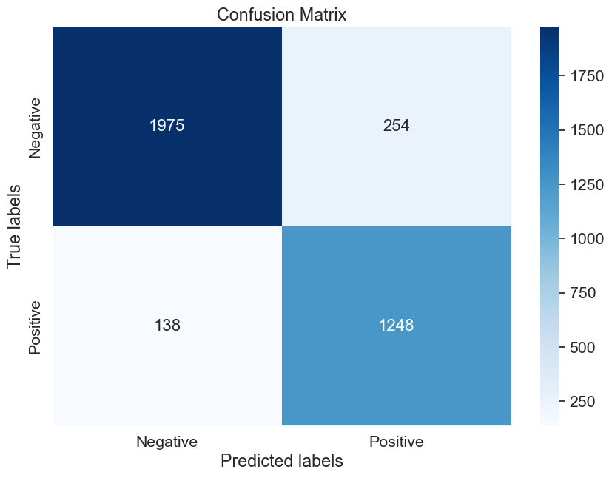
MODEL EVALUATION
Evaluated model on unseen test set of 50 songs
Results:
Accuracy: 0.891
F1 Score: 0.864
Precision: 0.831 (17% false positive rate)
Recall: 0.900 (10% false negative rate)
Notes:
We evaluated our model on an unseen test set of 50 songs.
Accuracy measures the percentage of correct predictions. Our model achieved an accuracy of 89.1% on the test dataset, which means it correctly classified chorus and non-chorus sections 89% of the time.
Considering that our label classes are slightly imbalance, with more non-chorus segments than chorus segments in songs, we also calculated precision, recall, and the F1 score. Our model achieved a precision of 0.831, indicating that when it predicts a section as a chorus, it is correct 83% of the time, the other 17% of the time it produces a false positive.
Our model achieved a recall of 0.9, meaning that it successfully identifies 90% of all the actual chorus segments in the test dataset, missing 10% of the chorus segments due to false negative.
In the confusion matrix, you can see the total number of correct predictions in the top left and bottom right, as well as the number of false positives on the top right, and false negatives on the bottom left.

Slide 16
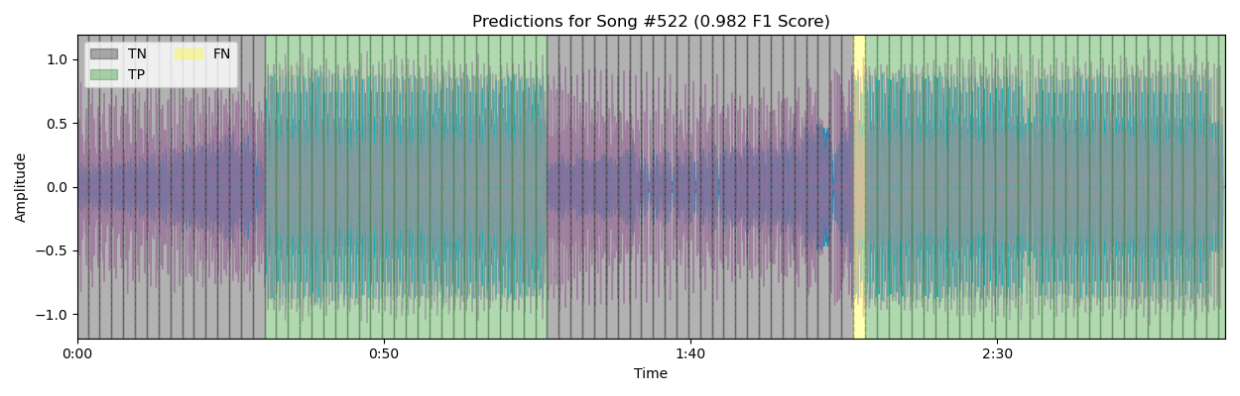
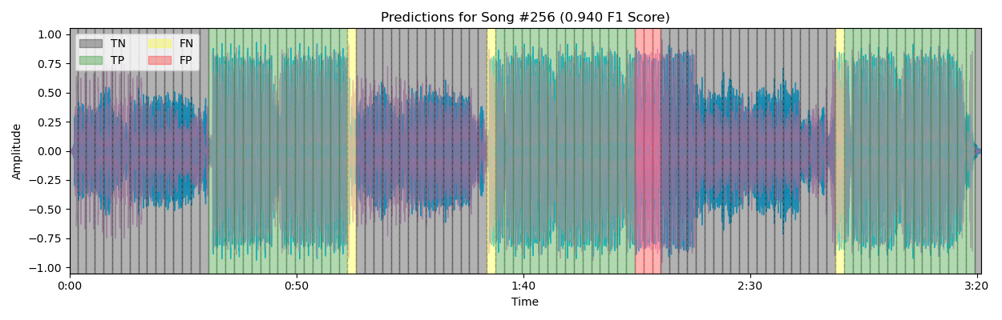
TEST PREDICTIONS
Notes:
To get a better idea of how this model was making predictions, we can visualize the predictions over the song it was tested on. Here are some successful examples in the test predictions.
here we have song with 2 large chorus sections, the model only missed 1 segment
Here we have a song with 3 choruses, and all 3 were pretty much spot-on aside from a few false negatives
With a lot of the examples we looked at with good but not perfect scores, they seemed to either be producing false positives or negatives towards the start or end of the actual chorus positions.

Slide 17
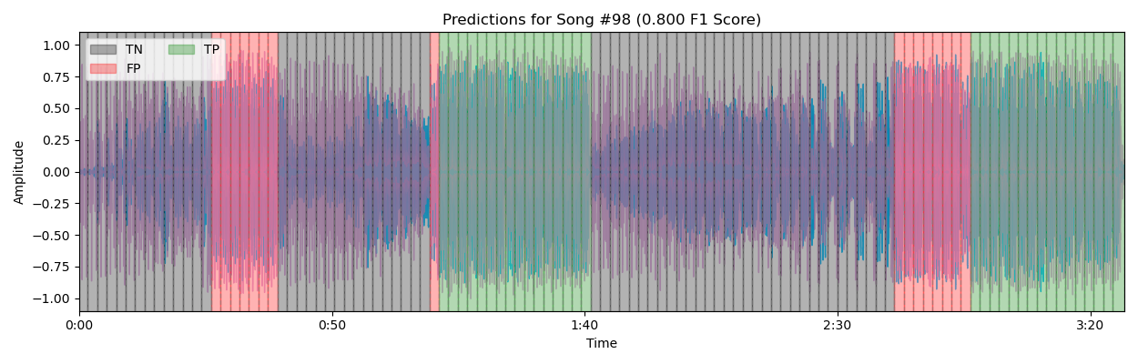
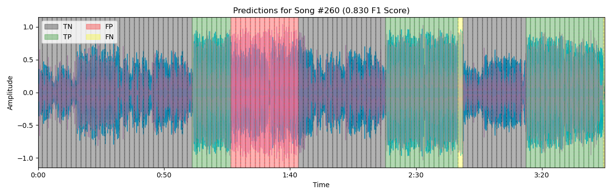
TEST PREDICTIONS
Notes:
Here are some less successful predictions with f1 scores around .8
here we have song with 2 large chorus sections, but the model seems to hallucinate more chorus segments than there are
similar instance

Slide 18
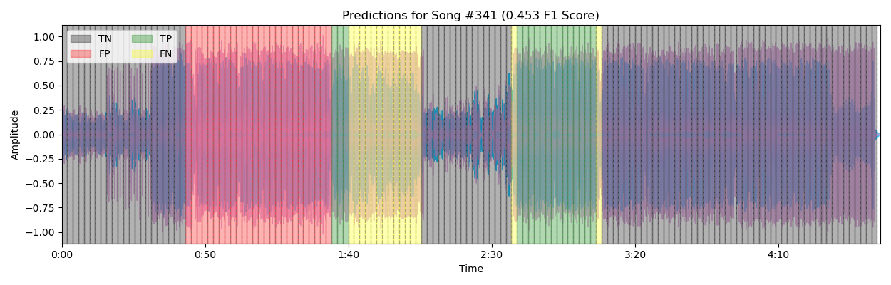
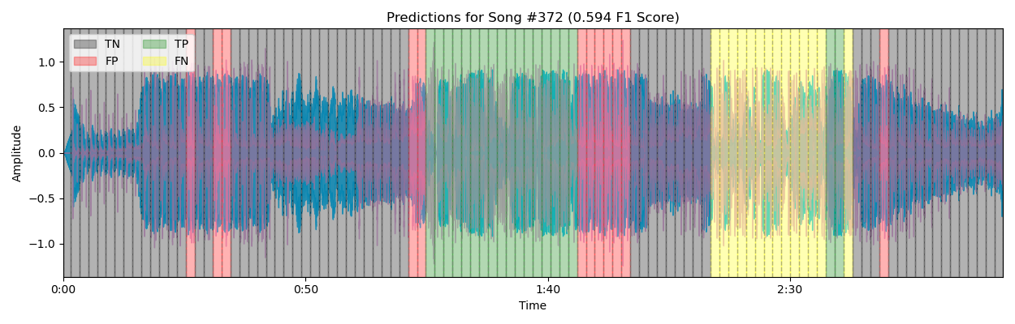
TEST PREDICTIONS
Notes:
And then we have some anomalies where we get reminded that this is a black-box model at the end of the day
here the model seems to completely miss the mark
here we have the model producing false positives in a way thats different than our successful examples. This could be due to a postprocessing step where i took probability greater than .5 and assigned it as chorus prediction, perhaps a more stringent threshold would resolve errors like these.

Slide 19
FUTURE CONSIDERATIONS
Prediction post-processing
Experiment on wider variety of genres
Experiment using multiple time-resolutions (e.g. frames, beats, meters)
Tuning feature weights and hyperparameters (e.g. filter size, batch size, LSTM units)
Notes:
To wrap things up, the results of our model is a promising start. Most predictions are only off by a few meters from the start/end of choruses, which is a good sign that these predictions can be smoothed out or combined with other downstream methods to produce more accurate predictions.
Additionally, we can expand our training and test data set to include a wider variety of genres to make a more generalizable model. In terms of modeling, we can augment our input data by adding in multiple time-resolutions and channels.
The model can also be improved with by fine-tuning feature weights and hyperparameters.

